Slide 1
Kaggle competition Optiver – Future Realized Volatility prediction
Jose Peeterson

Slide 2
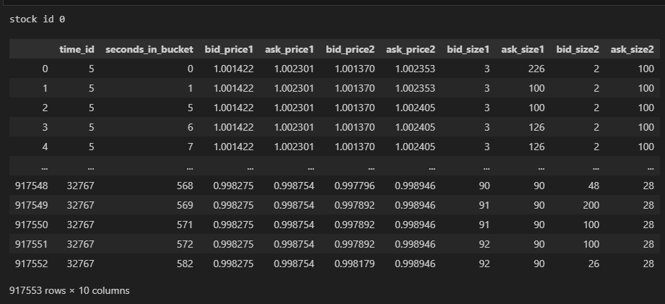
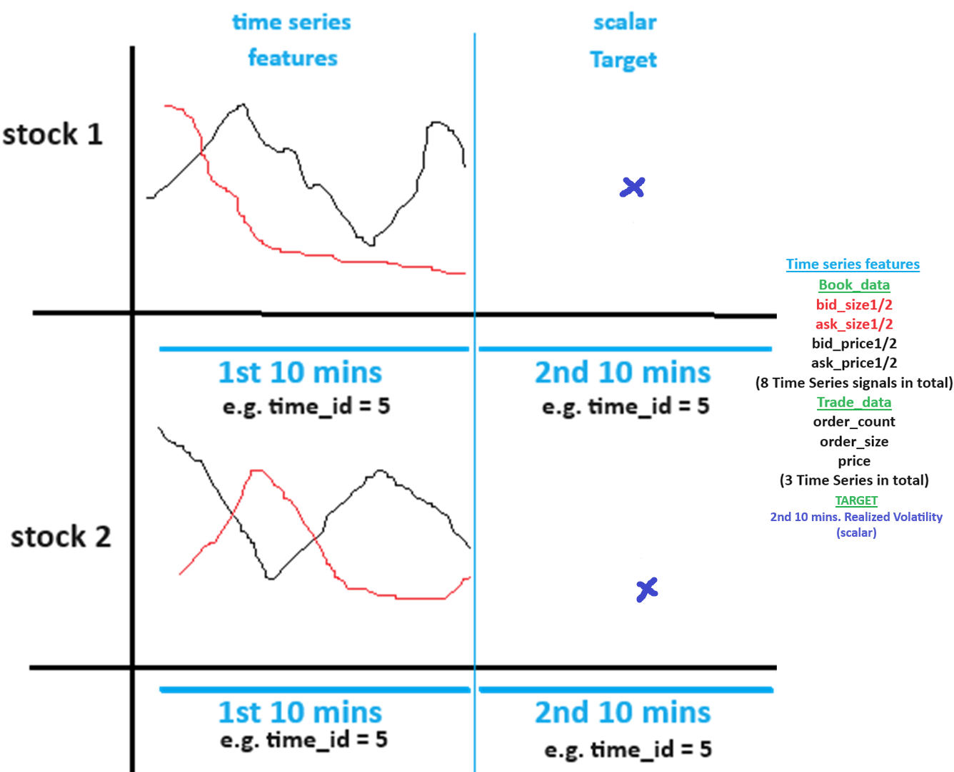
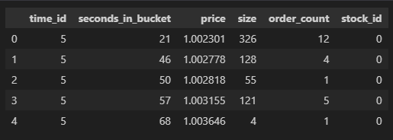
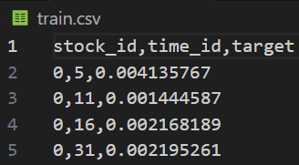
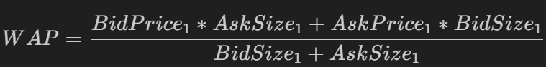
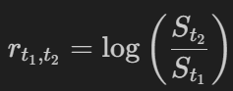
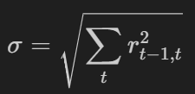
Background
Raw Data
book_train.parquet: contains sub-directory with 112 files. Each file e.g. a) below represents a stock and contains columns “time_id”, “seconds_in_bucket”, “bid_price1”, “ask_price1”, “bid_price2”, “ask_price2”, “bid_size1”, “ask_size1”, “bid_size2” ,”ask_size2”. “time_id ” is shuffled and NOT in ascending order. Inside a “time_id” the “seconds_in_bucket” are in ascending order although NOT consecutive.
Stock_id=0 : file schema/metadata shown on right
trade_train.parquet: contains sub-directory with 112 files of same stocks as above. It contains columns “time_id”, “seconds_in_bucket”, “price”, “size”, “order_count”, “stock_id”. “price” refers to actual trade execution price with prices weighted averaged by the order size (number of shares) in each transaction (order_count) in one second. “order_count” refers to the number of unique trade orders taking place. “size” refers to the sum number of shares traded from all the order_counts.
train.csv: contains columns “time_id”, “target”, “stock_id”.

Slide 3
Feature Engineering (RAW Features)
Notes:
class create_training_n_inference_general_features( object ):
General features are raw features.

Slide 4
Feature Engineering (Liquidity Features)

Slide 5
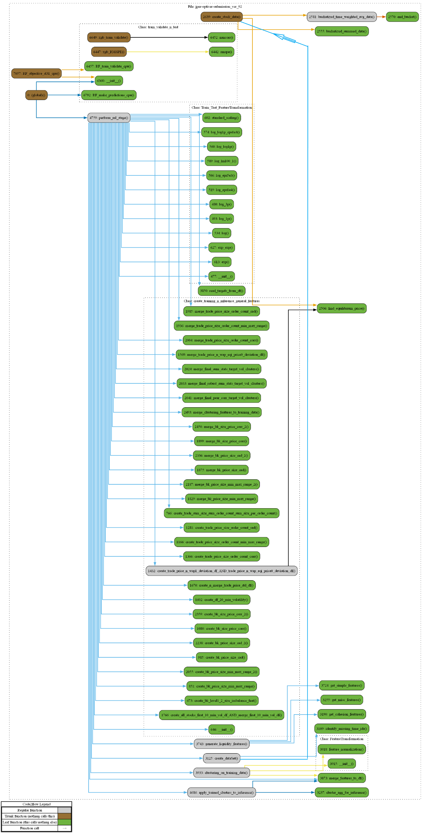

Code control flow using code2flow package.

Slide 6
Clustering performance analysis
Identify groups and subgroups of similar stocks through hierarchical clustering
Limit to clustering on a single attribute in a model. This ensures that the model is not confused by the same stock in clusters with different groups of stocks due to clustering on different attributes.
Try clustering on various different attributes and identify the one that leads to prediction performance improvement.
Clustering on the input feature (wap1_log_price_ret_buks)
Perform PCA on the feature matrix (time_id x stock_id) to reduce noise in the returns data.
Use agglomerative clustering over the principal components to cluster the stocks. The mean of the cluster is used to initialize the cluster center of a Gaussian mixture model to find the final clusters.
Grid search through agglomerative clustering hyperparameters to select clustering with the highest within cluster feature correlation.
Notes:
Clustering on the target achieved through: clustering_on_training_data( )
apply_trained_clusters_to_inference( ) for testing data
final_sum_stats_target_vol_clusters contains clusters formed using the TARGET
final_sum_stats_target_vol_df is a feature formed by aggregating first_10_min_vol_df using final_sum_stats_target_vol_clusters

Slide 7
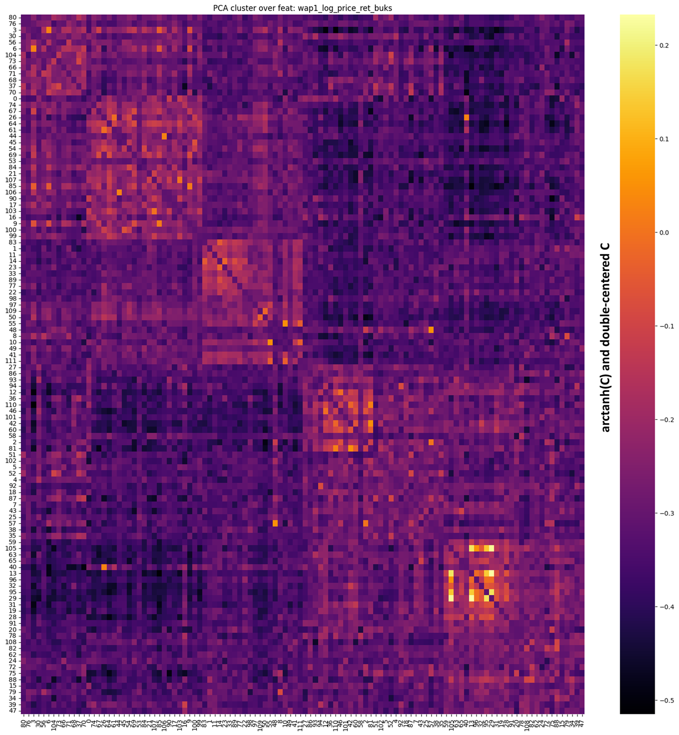
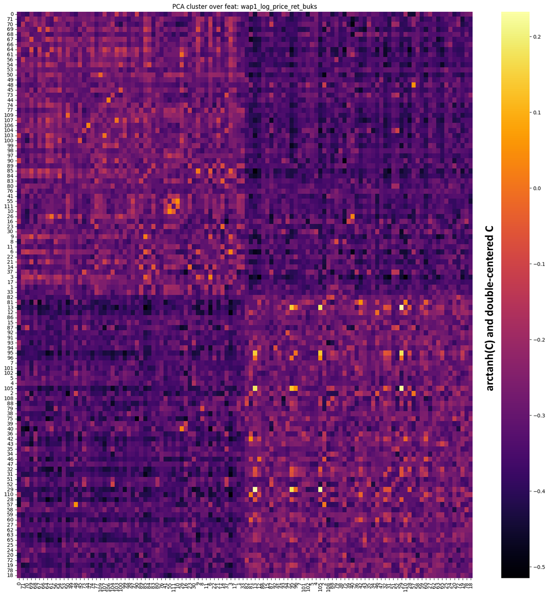
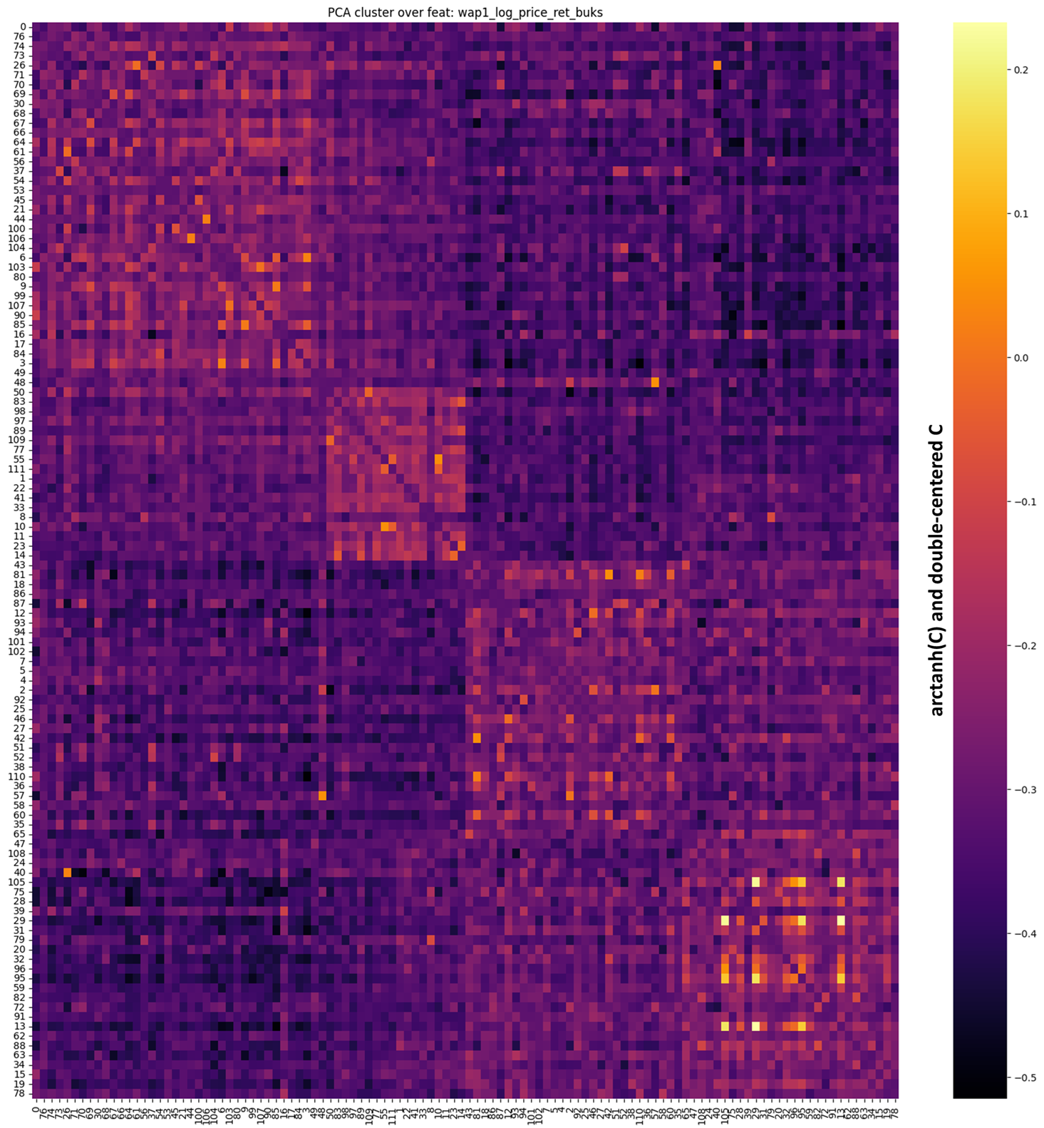
Clustering performance analysis
Observation:
Inference:
Improvement suggestion:
PCA
To search through hyperparameters to get the best
Objective: High within cluster correlation Feature importance of this clustering feature in the feature importance chart.

Slide 8
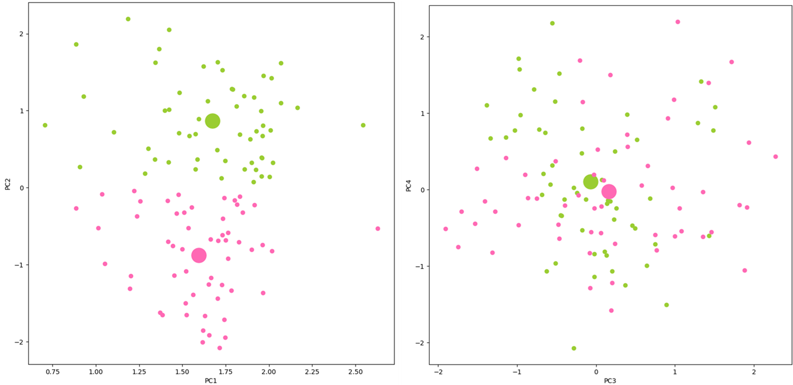
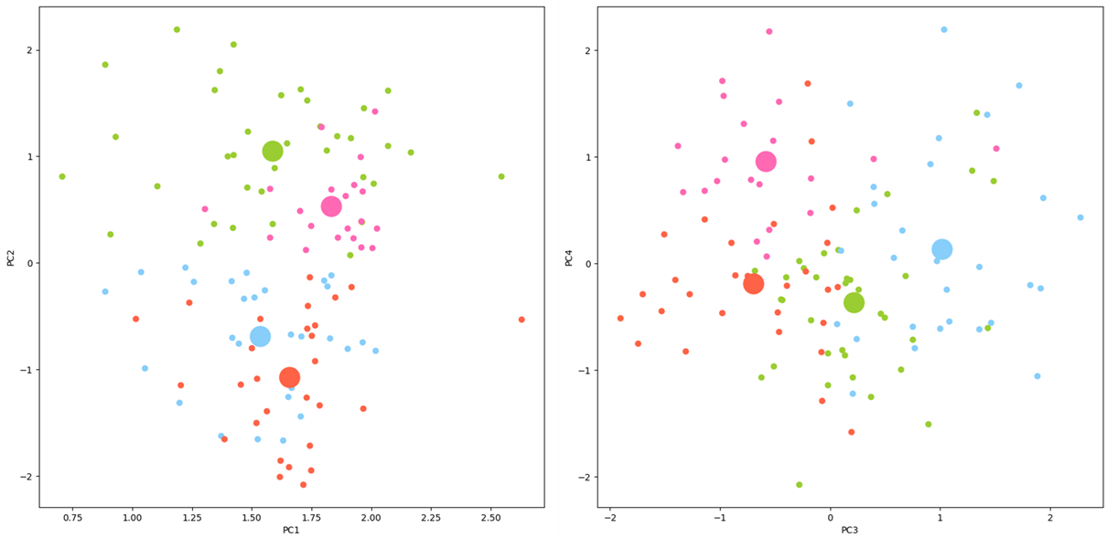

Slide 9
Clustering performance analysis
Clustering on the target
Pearson correlation
Summary statistics :
Feature importance of this clustering feature in the feature importance chart.
Observation:
Inference:
Improvement suggestion:
Notes:
Clustering on the target achieved through: clustering_on_training_data( )
apply_trained_clusters_to_inference( ) for testing data
final_sum_stats_target_vol_clusters contains clusters formed using the TARGET
final_sum_stats_target_vol_df is a feature formed by aggregating first_10_min_vol_df using final_sum_stats_target_vol_clusters

Slide 10
Training Routine
Optuna to search best xgboost hyperpameters using 10-fold cross validation.
Raw target Vs. Transformed target (Volatility ratio)
Target spans several orders of magnitude which makes learning difficult. First 10 min. real. Vol. is highly correlated with target.
Weighting of target samples
Relative errors of low real. Vol. samples are higher than high real. Vol. samples
Observation:
Inference:
Improvement suggestion:
Notes:
Clustering on the target achieved through: clustering_on_training_data( )
apply_trained_clusters_to_inference( ) for testing data
final_sum_stats_target_vol_clusters contains clusters formed using the TARGET
final_sum_stats_target_vol_df is a feature formed by aggregating first_10_min_vol_df using final_sum_stats_target_vol_clusters

Slide 11
Prototype (i.e. initial) model output
A single model for all stocks
Best trial:
Best number of iteration/boosting rounds: 1135
Trial no.: 32
Value: 0.22699900086611163
Params:
max_depth: 17
eta: 0.012302593098587278
subsample: 0.75
colsample_bytree: 0.8
gamma: 0
reg_alpha: 11
reg_lambda: 8
min_child_weight: 6
####################################### PREDICTION #################################################
corr(y_pred/v1ts, y_true/v1ts) 0.4592863365106767
log(corr( )) 0.5351106470319219
corr(y_pred, y_true) 0.9057492349057186
log(corr( )) 0.9185397908698034
RMSPE train score: 0.19065680871350316
RMSPE test score: 0.23036724443746043
Competition score: 0.22021 (Version 19)
Observation:
Inference:
Improvement suggestion:
Notes:
Refer to document: ver-33-Error_log_and_analysis

Slide 12
Error Analysis
Clustering error analysis
Total error analysis
Stock_id-wise error analysis
Train set
Test set
Gauge test set representativeness of the train set distribution and model’s generalization ability.
Check if average walk-forward validation error and test set error are positively correlated for different hyperpameter trials. This ensures improvements on the validation set will lead to improvements in the test set.
Time_id-wise error analysis
Individual instance-wise error analysis
Shapley feature importance based error analysis
Shapley Underprediction and Overprediction analysis
Shapley interaction effects analysis
Observation:
Inference:
Improvement suggestion:

Slide 13
Error Analysis
Clustering error analysis
Total error analysis
Stock_id-wise error analysis
Train set
Test set
Gauge test set representativeness of the train set distribution and model’s generalization ability.
Check if average walk-forward validation error and test set error are positively correlated for different hyperpameter trials. This ensures improvements on the validation set will lead to improvements in the test set.
Time_id-wise error analysis
Individual instance-wise error analysis
Shapley feature importance based error analysis
Shapley Underprediction and Overprediction analysis
Shapley interaction effects analysis
Observation:
Inference:
Improvement suggestion:

Slide 14
Clustering Error Analysis
Pearson
Sum stats
Robust sum stats
PCA

Slide 15
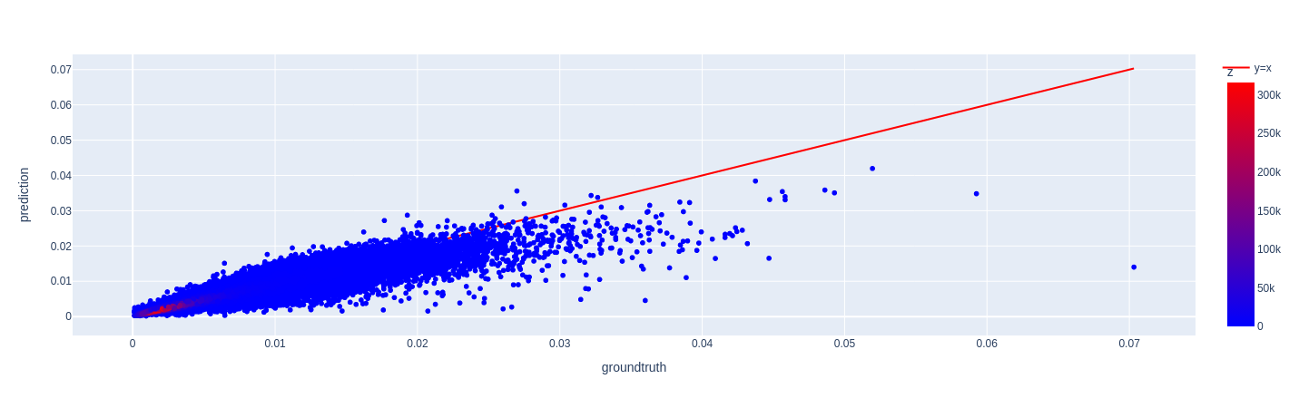
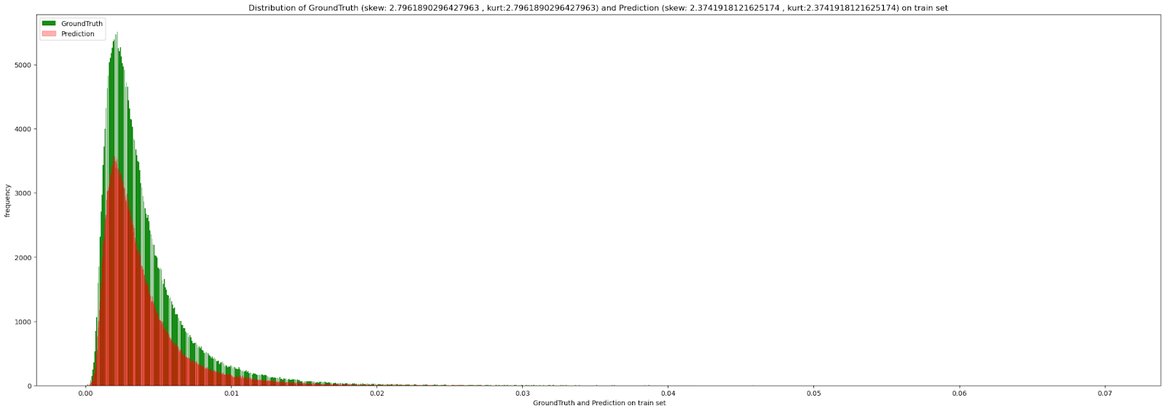
Train set Error Analysis Total error analysis
The model is biased towards underprediction. The errors in smaller real. Vol. values have larger magnitudes in RMSPE calc. Due to the denominator. So we weighed smaller real. Vol. valued samples larger during training. Therefore the cone starts from origin to top right of the graph. This could be the reason for underprediction.
the model may be missing some non-linear relationship.
the error from overprediction is more than underprediction as identified below.
GAPS and DISCONTINUITY in Target distribution: the green distribution is DISCONTINUOUS with many gaps in between values leading to a fatter tail. The red distribution on the other hand is more continuous. If we can make the target more continuous by log transformation it might help with reducing error.

Slide 16
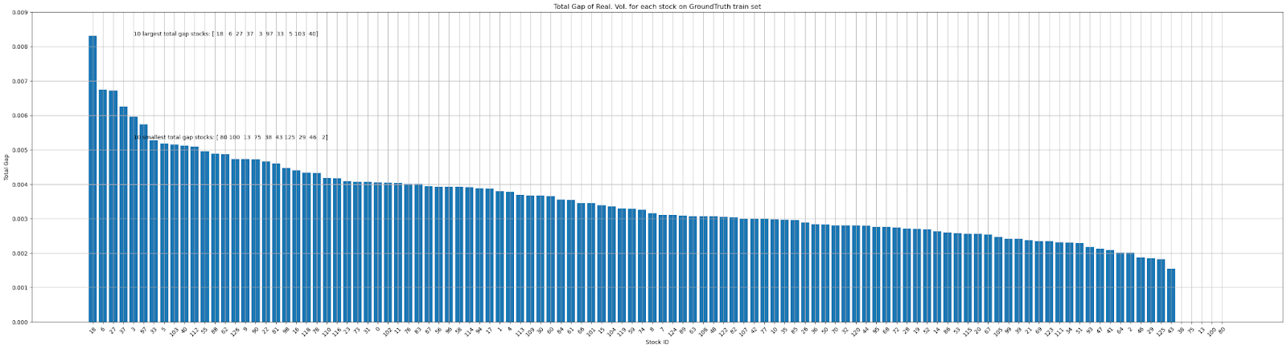
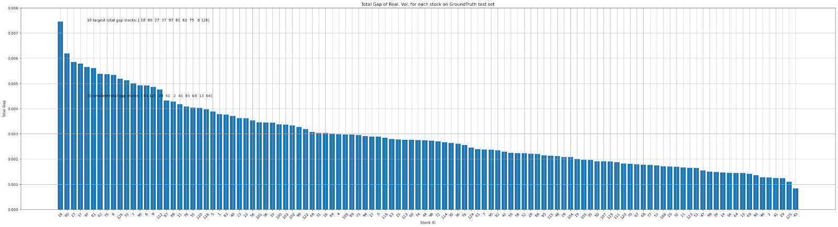
Train set Error Analysis Total error analysis
Relationship between Gaps in target histogram and high RMSPE
Train set
Intersection of stocks in 30 largest total gap stocks and 30 largest RMSPE stocks. In the top 30 stocks, 19 are the same in both sets.
{'0', '103', '110', '112', '16', '18', '27', '3', '31', '33', '37', '40', '5', 81', '88', '9', '90', '97', '98'}
Note: stock 31 does not have as much gap as other high RMSPE stocks.
Test Set
Intersection of stocks in 30 largest total gap stocks and 30 largest RMSPE stocks . In top 30 stocks 15 are the same in both sets.
{'11','110', '112', '116', '18', '27', '33', '37', '40', '5', '75', '78', '88',
'9', '90'}
Observation:
Inference:
Improvement suggestion:

Slide 17
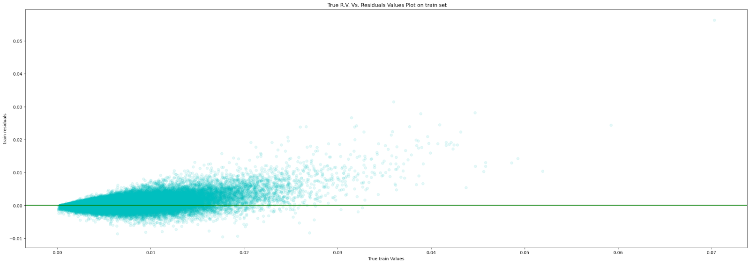
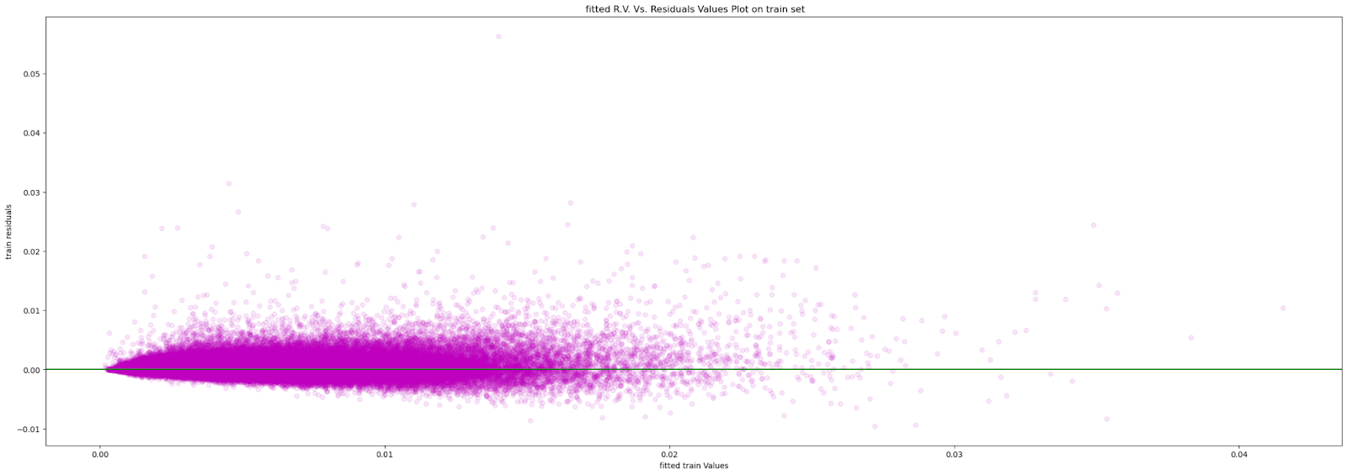
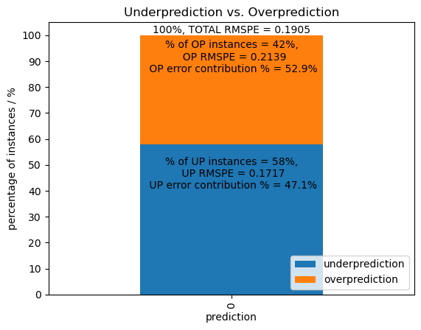
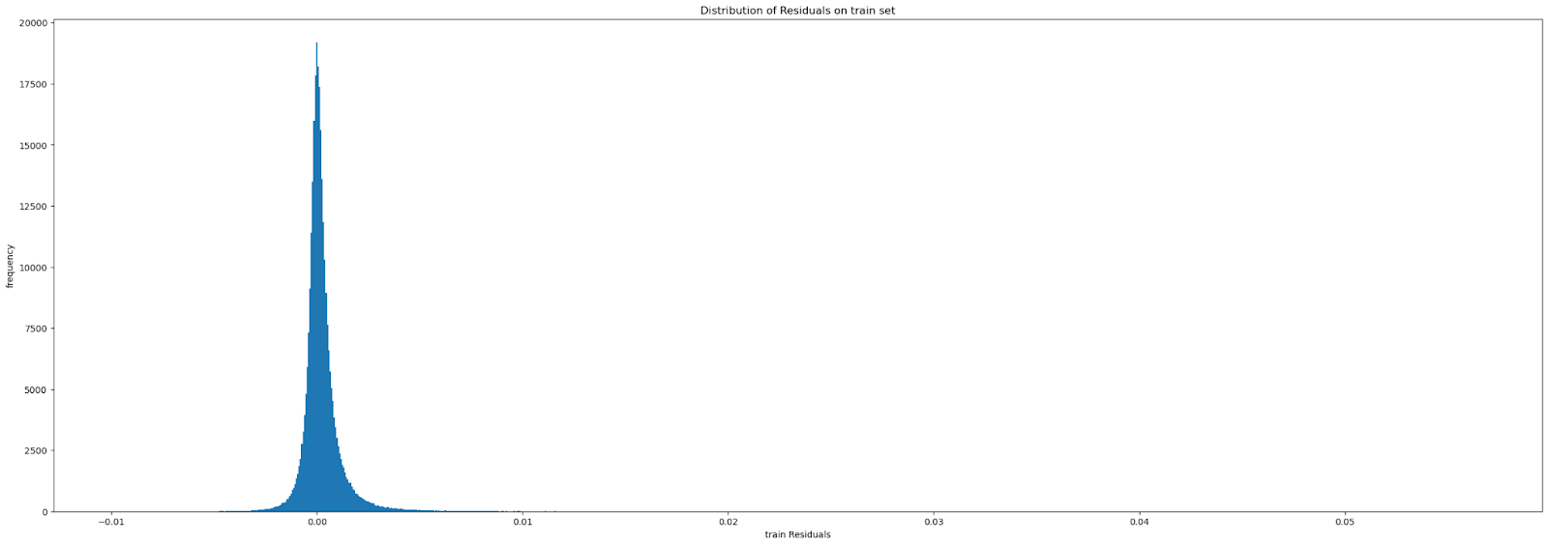
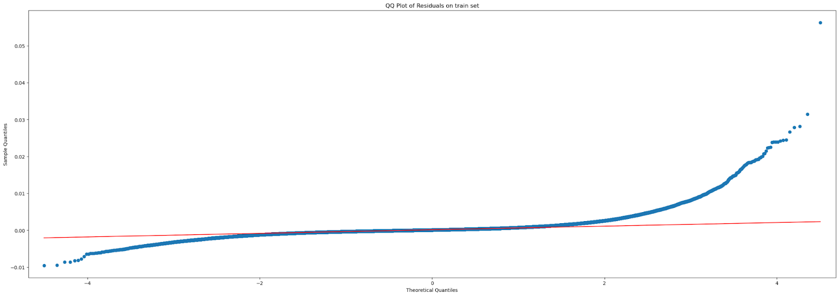
Train set Error Analysis Total error analysis
Residual = y_true - y_pred,
Residuals are slightly biased towards underprediction. Positive outlier residuals are present for higher true values, suggesting the model struggles with extreme values.
Heteroscedasticity: The variance of the residuals is not constant across all levels of the realized volatility. some non-linear relationship is not captured.
Potential Model Improvement: The model might benefit from additional features or transformations that specifically address the stocks with higher volatility.
underprediction contributes 47.1% and overprediction contributes 52.9% to the squared RMSPE.
There is a slight right tail. right skew.

Slide 18
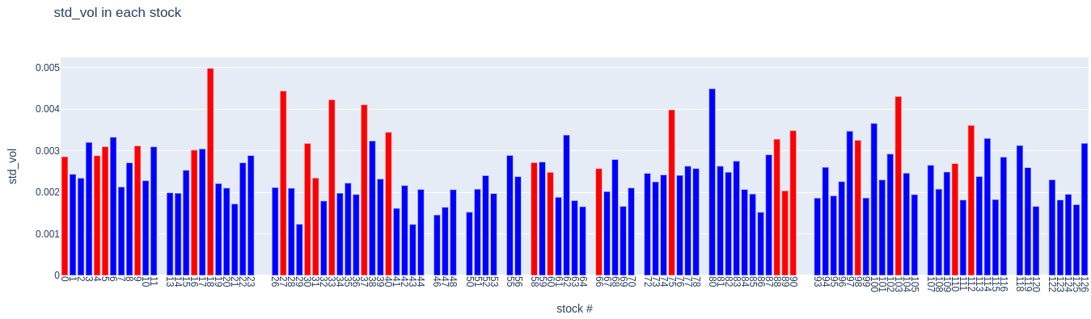
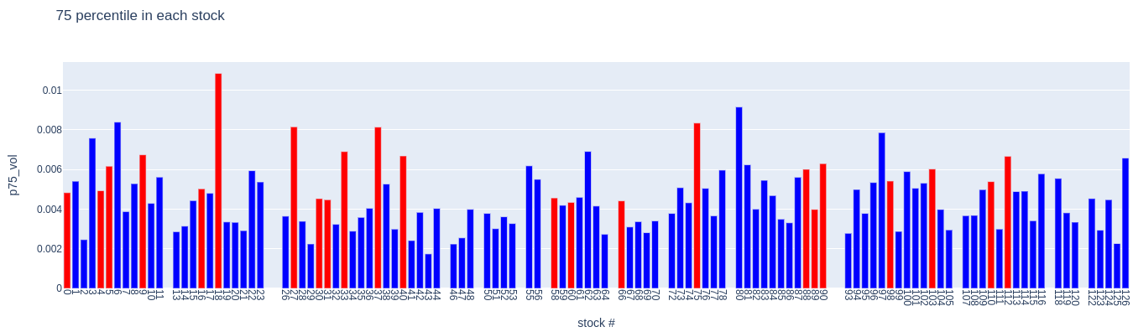
Train set Error Analysis Total error analysis
These high rmspe stocks (in red) also have larger standard deviation, compared to other stocks.
These high RMSPE stocks were NOT found to be highly kurtotic or highly skewed. They are just more spread out/ High STD and 75th percentile.
Improvement: jager transform, Log transform target and target shift?

Slide 19
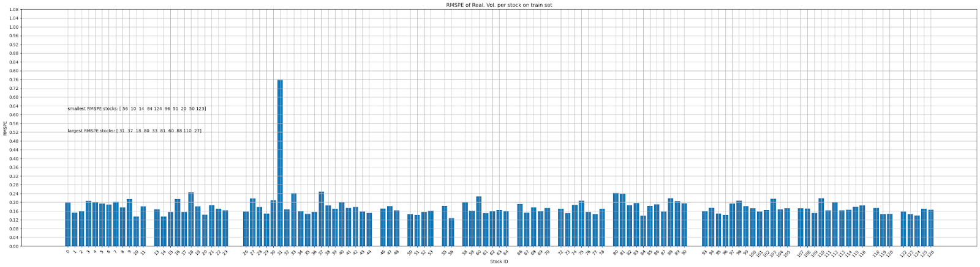
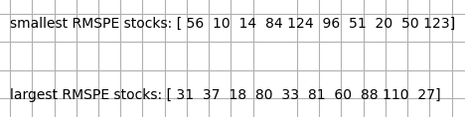
Train set Error Analysis Stock_id-wise error analysis
Train set
Observation:
Inference:
Improvement suggestion:

Slide 20
Train set Error Analysis Stock_id-wise error analysis
Stock_id 31
Model fitted better to all other stocks compared to stock 31. Learn stock id 31 using a separate model and predict it separately.
stock id 31 has significantly higher error compared to other stocks. It’s behaviour might be inverse of the majority of the stocks. So Rules learnt for other stocks may apply inversely to this stock.
Rapidly evolving external forces affected the order book differently in the 2nd 10 minutes.
Inconsistent behaviour between the two 10 minutes. The first 10 minutes is not indicative of the 2nd 10 minutes. Rapidly changing order book dynamics in the first 10 and second 10 minutes.

Slide 21
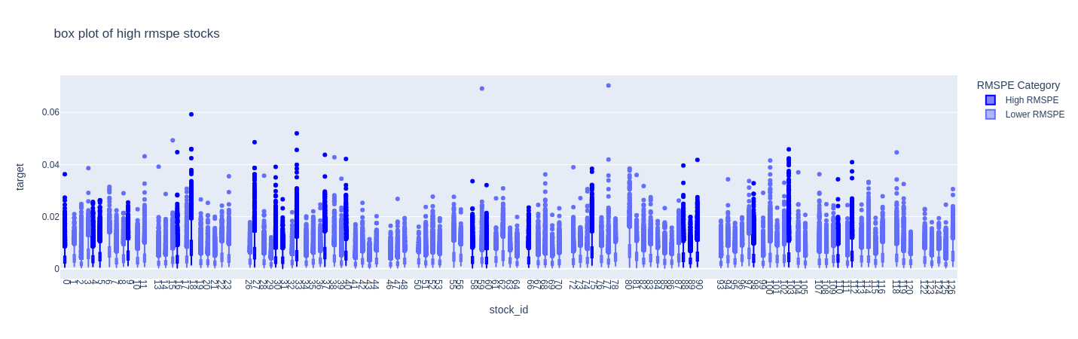
Train set Error Analysis Stock_id-wise error analysis
Generally, these stocks have more outliers that are larger. Many points lie outside IQR that are spread out to larger real.vol.
Observation:
Inference:
Improvement suggestion:

Slide 22
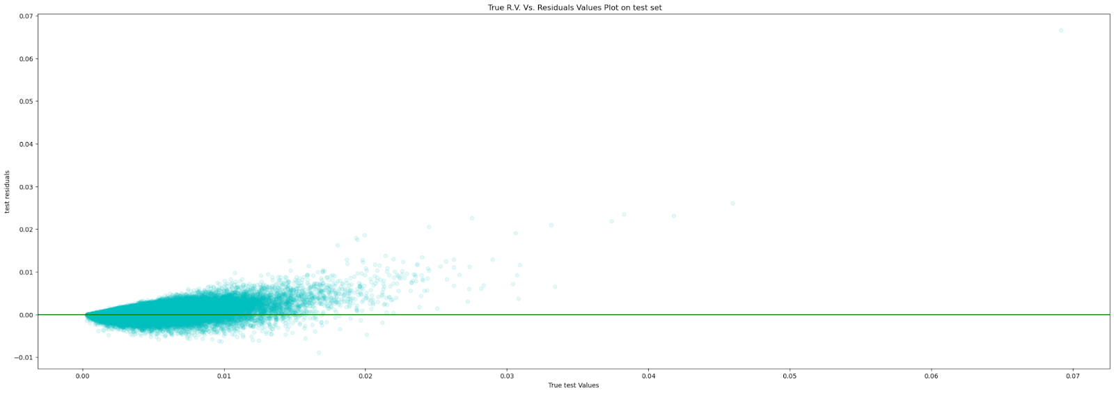
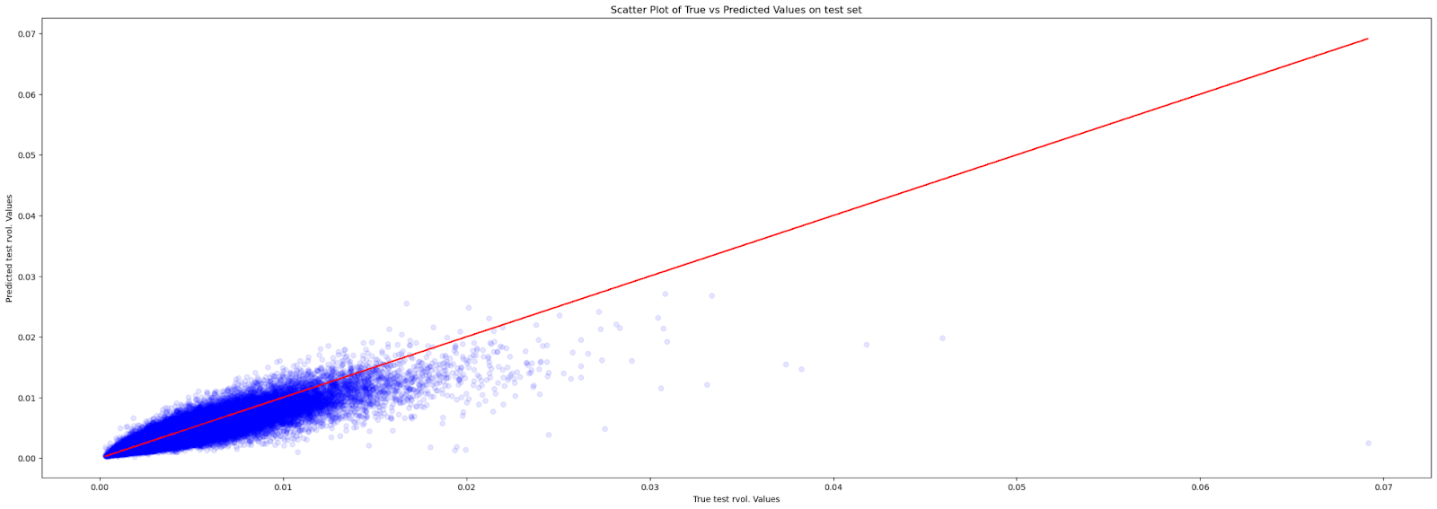
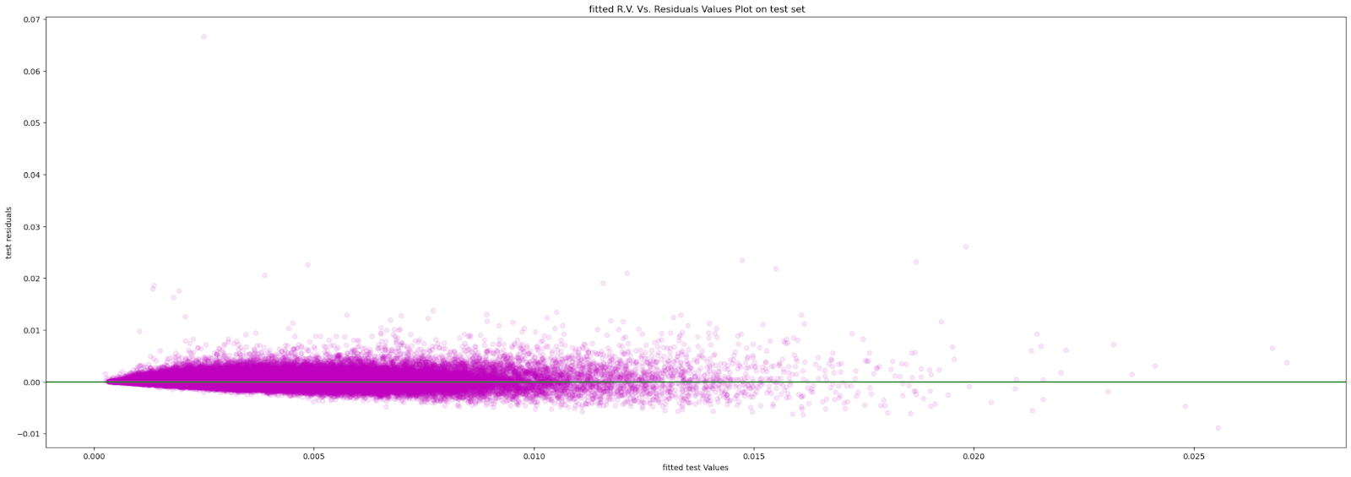
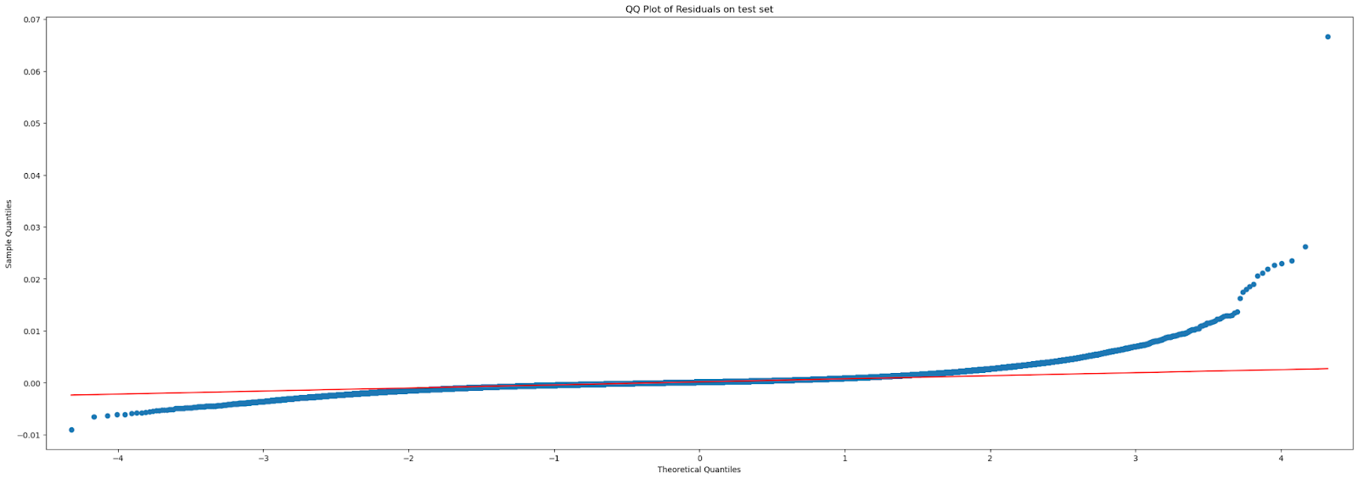
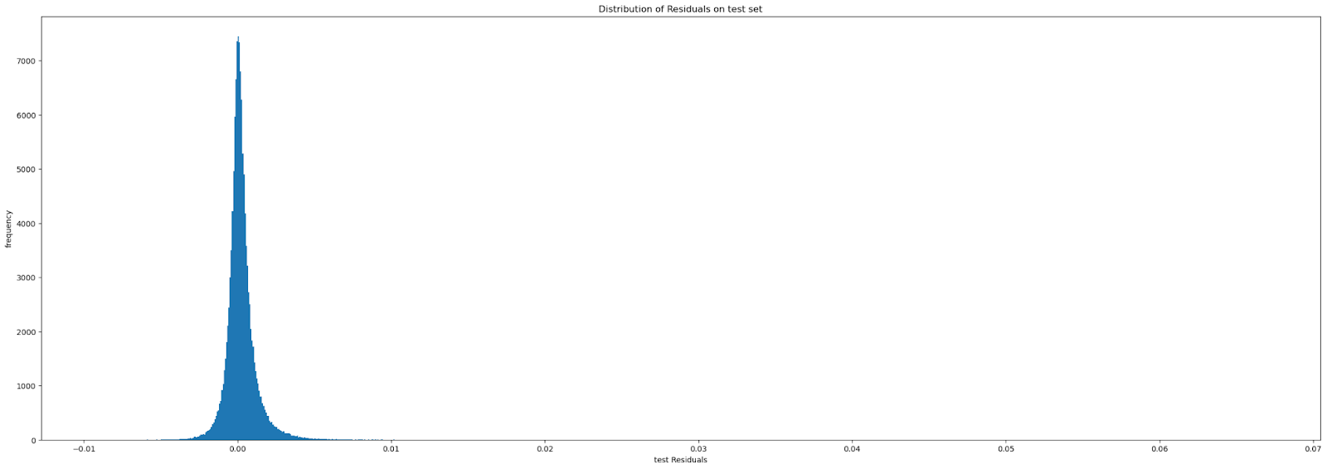
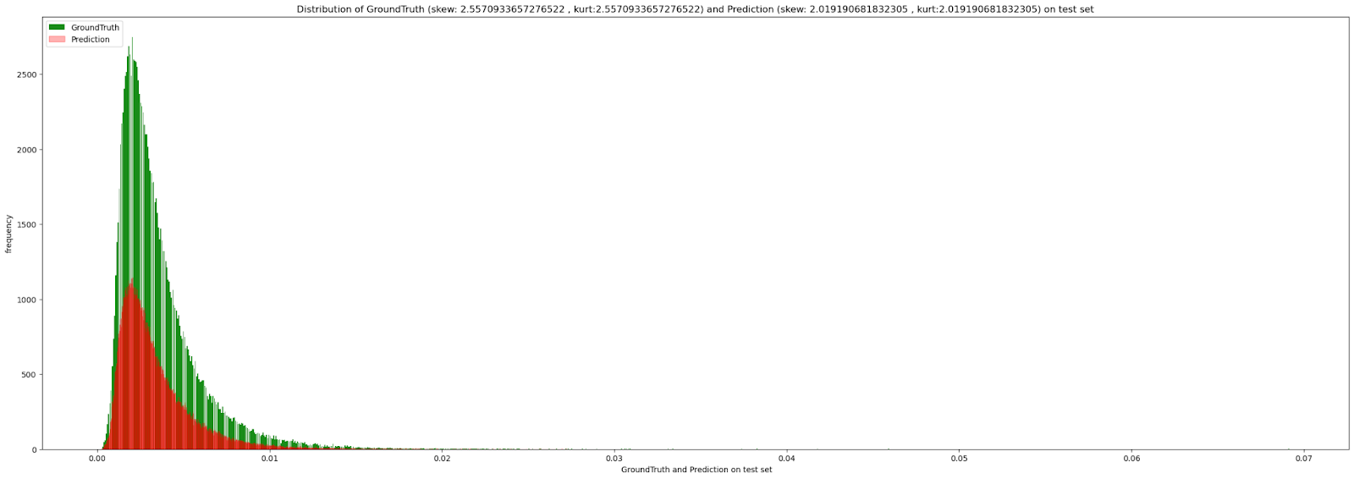
Test set Error Analysis Total error analysis
The behavior is very similar on the test set as well. This indicates that the model may NOT be overfitting but rather needs to increase its complexity and learn more complex patterns in data.

Slide 23
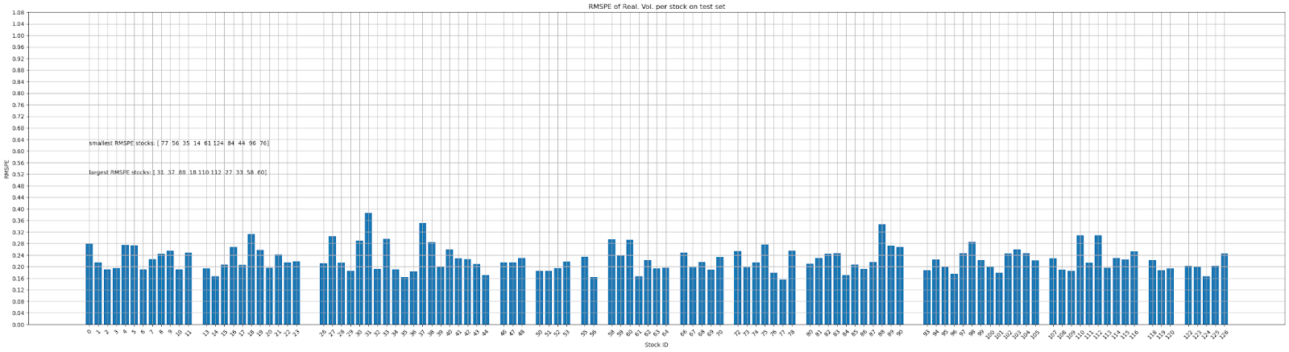
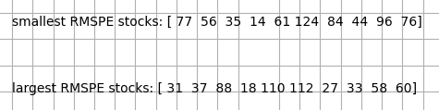
Test set Error Analysis Stock_id-wise error analysis
Test set
Observation:
Inference:
Improvement suggestion:

Slide 24
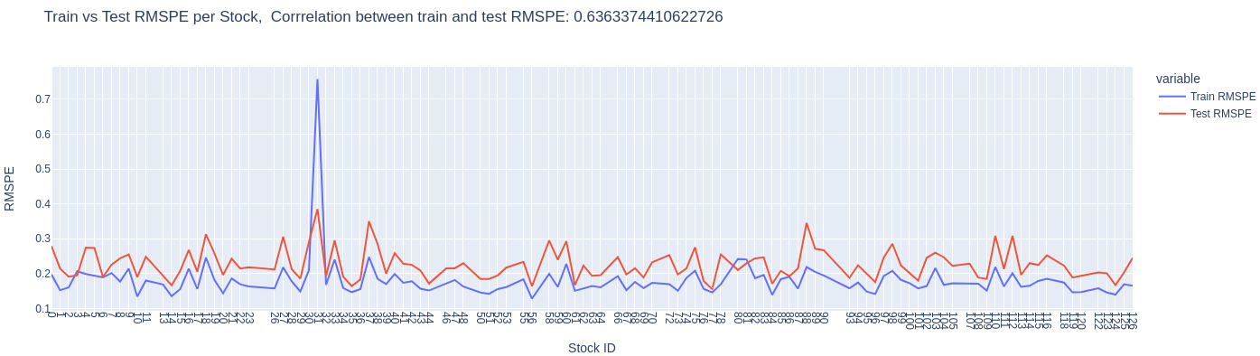
Test set Error Analysis Stock_id-wise error analysis
The behavior is very similar on the test set as well. This indicates that the model may NOT be overfitting but rather needs to increase its complexity and learn more complex patterns in data.
This graph and high correlation helps us to conclude that the model might be underfitting as the stocks with high train errors are also stocks with high test errors. improving the prediction accuracy on the training set might also improve the test set accuracy.

Slide 25
Test set Error Analysis Stock_id-wise error analysis
Looking at the largest RMSPE stocks in both Train and Test sets
Inference: The same stocks with the largest training error are also the stocks with the largest testing error.
Intersection of stocks in train and test set. In top 30 stocks 23 are the same in both sets.
['31','37', '18','33', ‘112', '88','60','110','27', '9','16','30', '103', '5', '58', '89', '66', '40', '0', '4', '75', '90', '98']
model might be underfitting for these stocks.
the errors are correlated between training and testing indicates that the model's performance is consistent across both datasets. This suggests that the model generalizes well in terms of the relative ranking of stocks' prediction difficulties but might still have overall accuracy issues.
techniques tailored to these stocks with higher errors.
Observation:
Inference:
Improvement suggestion:

Slide 26
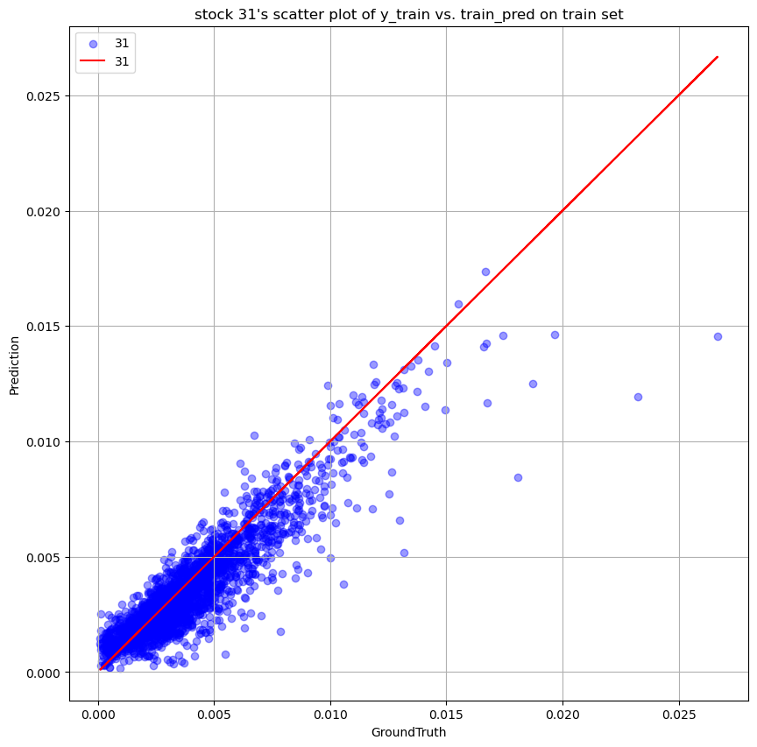
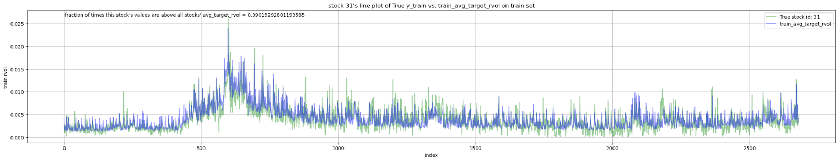
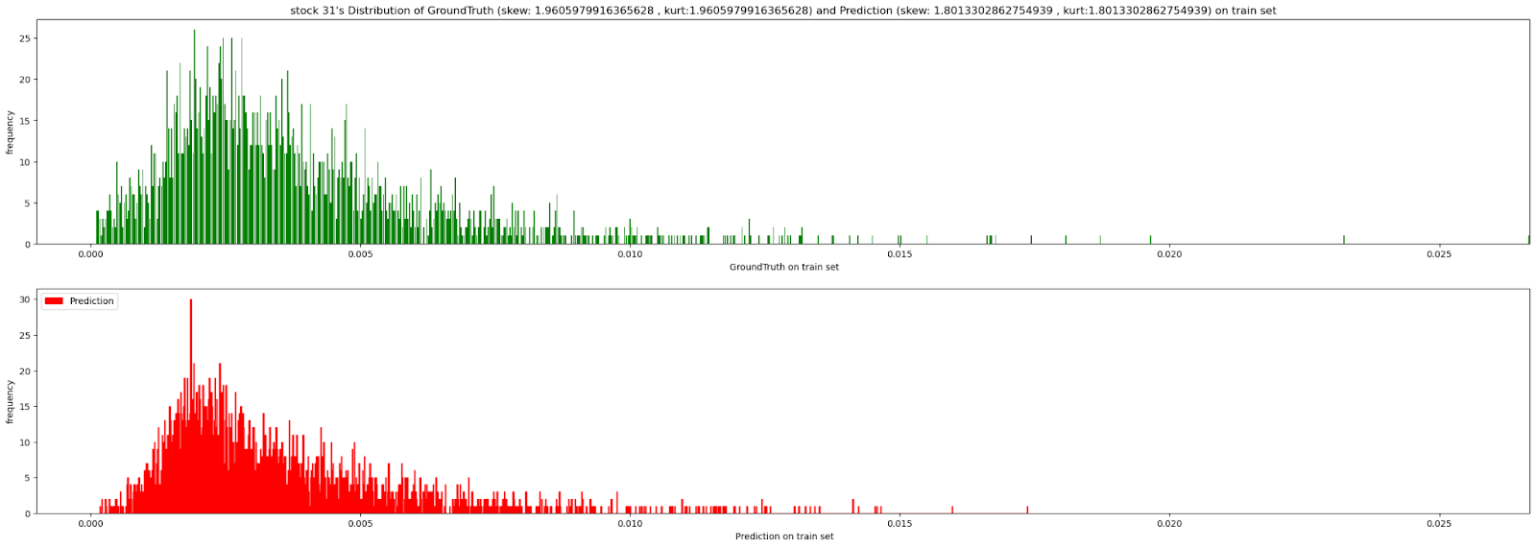
Train set Error Analysis Stock_id-wise error analysis
Stock id 31
It is below the average most of the time.
Notice GAPS or DISCONTINUITIES in the GROUNDTRUTH Target. I.e. white spaces in the support of the histogram. Xgboost predictions is unable to make such spread out target predictions as support in predictions do not have much white spaces.
The fat right tail in both train and test targets.
Stock id 31’s real. Vol. very small in general and values are close to zero
Observation:
Inference:
Improvement suggestion:

Slide 27
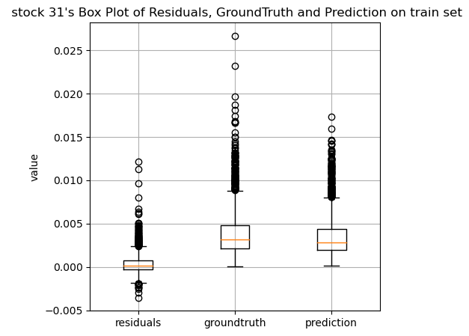
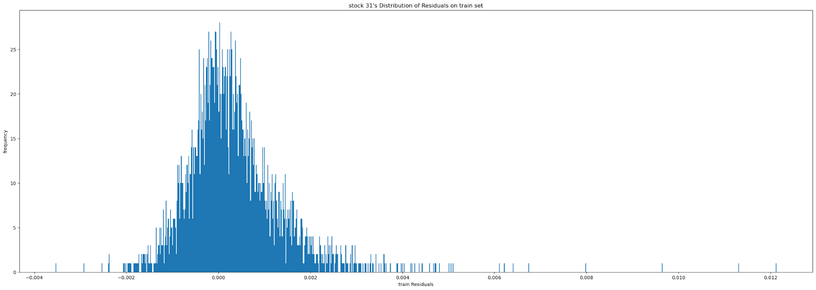
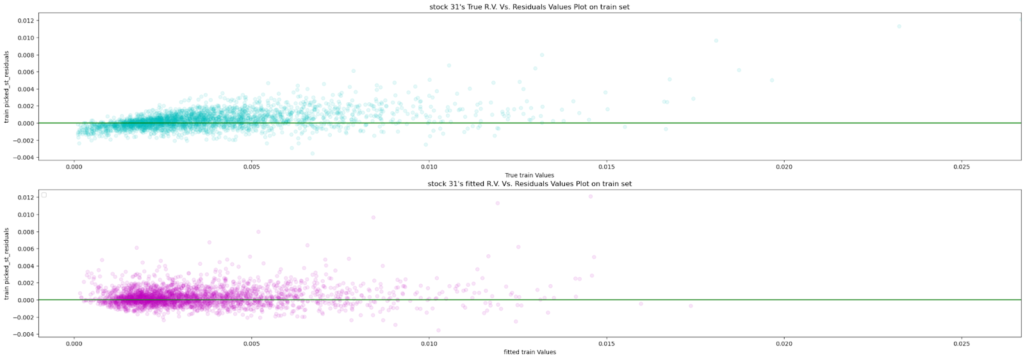
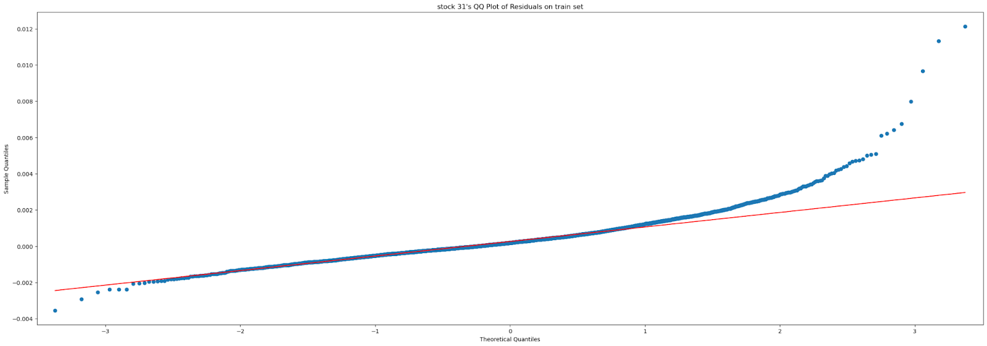
Train set Error Analysis Stock_id-wise error analysis
Stock id 31
REsiduals have Right skew and fat tail
Residuals are normally distributed. But underprediction is more prevalent.
As the stock 31 data distribution is not as heavy tailed as other stock’s with high RMSPE. The fraction of times above mean is very low. This requires specific novel feature engineering tailored to stock id 31.

Slide 28
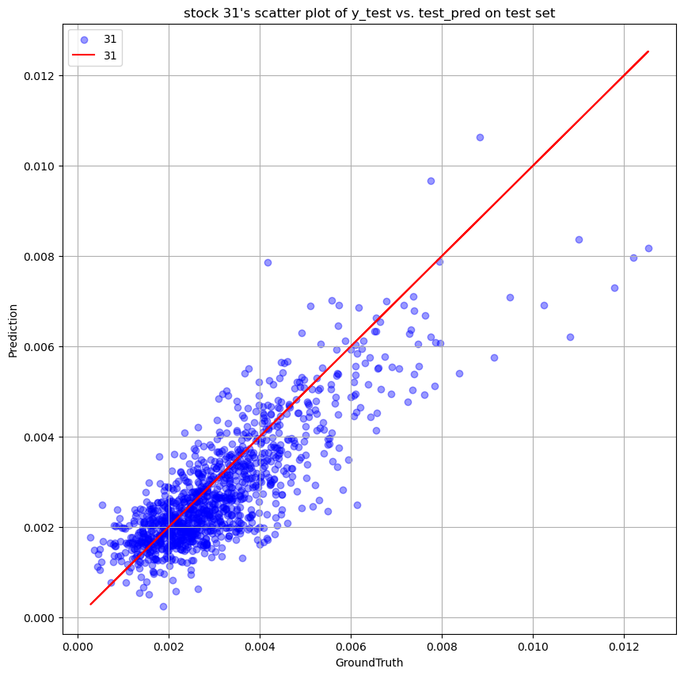
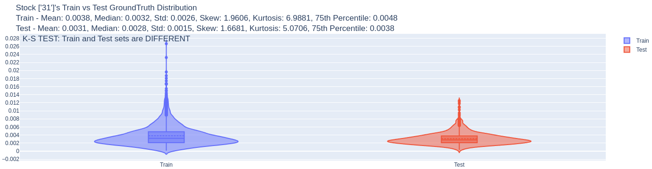
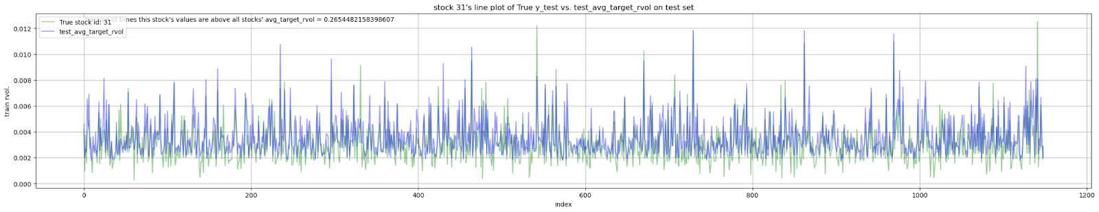
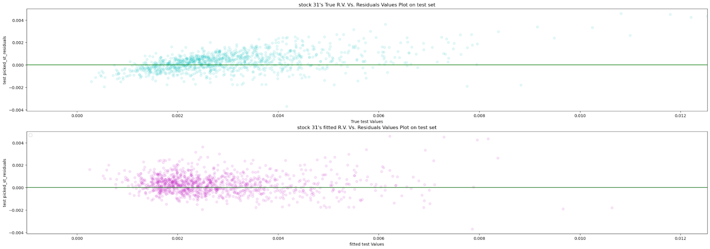
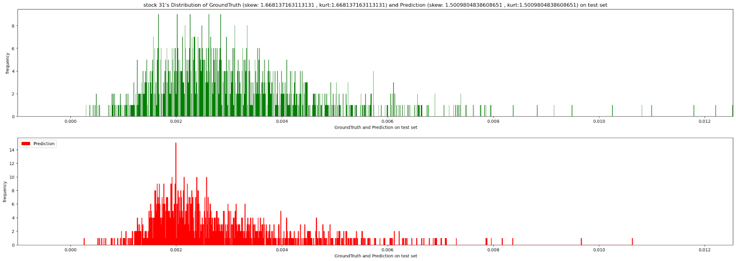
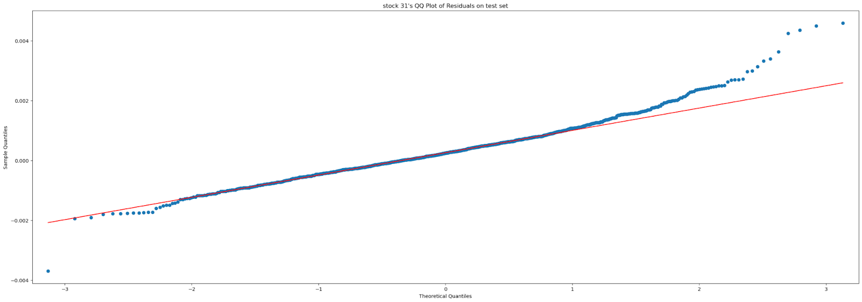
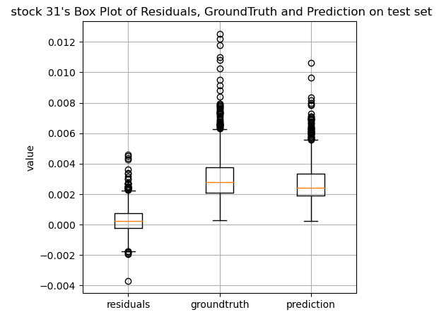

Test set Error Analysis Stock_id-wise error analysis
Stock id 31
There is good overlap between trade and test set distributions.

Slide 29



Train set Error Analysis Stock_id-wise error analysis
Characteristics of remaining high RMSPE stocks.
Stock ids: 37, 18,33 112, 88, 27,9 :
Most of the time above average
Most of the real. Vol. values are above averagel in general so features that capture the tail behaviour are important.
Stock id: 110
Around average
Stock id: 60
Most of the time it is below the mean. Real. vol.values are quite small and closer to zero. This stock’s behaviour (fraction of times < mean) is similar to stock id 31, I.e. the largest RMSPE stock.

Slide 30


Train set Error Analysis Time_id-wise error analysis
Reducing the first 10 time ids with high RMSPE
Time ids where average real. Vol. (over all stocks) is relatively larger are 27174, 8534, 2479 (2nd, 3rd and 4th largest avg. real. vol.) that still have large RMSPE. Time ids with small average real. Vol. (over all stocks) tend to have the largest RMSPE in general. All other large RMSPE Time ids have smaller avg. real. Vol. There are also two time ids where average vol. Is high and there are large RMSPE.
Conversely, time ids with larger real. Vol. tend to have lower RMSPE.
Improvement suggestion: We could apply larger learning weights to this time id alone.
Observation:
Inference:
Improvement suggestion:

Slide 31





Train set Error Analysis Time_id-wise error analysis
In the graphs below, RMSPE is high wherever the groundtruth is a small value and NOT necessarily when deviations between actual and prediction are big.
All real. Vol. points are within the 25th percentile to 75th percentile of the data (middle 50%). These are not outliers. Stock id 31 is the leading contributor of RMSPE. It has an abnormally low Real. vol. Compared to other stocks. Stock id 55 & 62 also have large deviations.
The boxplots in the background help to indicate generally where in the distribution the error happens.
Notes:
Ipynb File : submission-ver-33-error-analysis.ipynb

Slide 32





Train set Error Analysis Time_id-wise error analysis
All real. Vol. points are within the 25th percentile to 75th percentile of the data (middle 50%). These are not outliers. Stock id 31 is the leading contributor of RMSPE. It has an abnormally low Real. vol. Compared to other stocks. Stock id 55 & 62 also have large deviations.
Predictions tend to be neither over nor under predictions. Real. vol. Values are very small, often below the 25th percentile value. But Stock id. 31 has abnormally low real. Vol. value. Stock id 18 has large deviation.
Notes:
Ipynb File : submission-ver-33-error-analysis.ipynb

Slide 33





Test set Error Analysis Time_id-wise error analysis
Observation:
Inference:
Improvement suggestion:
Notes:
Ipynb File : submission-ver-33-error-analysis.ipynb

Slide 34





Test set Error Analysis Time_id-wise error analysis
Notes:
Ipynb File : submission-ver-33-error-analysis.ipynb

Slide 35


Train and test set Error Analysis Time_id-wise error analysis
Large Over predictions
Stock: 31,30, 58,59,60,3
Large Under predictions
Stock: 55,62,61,80,37
Observation:
Inference:
Improvement suggestion:
Notes:
Ipynb File : submission-ver-33-error-analysis.ipynb

Slide 36


Train set Error Analysis Time_id-wise error analysis
Observation:
Inference:
Improvement suggestion:
Notes:
Ipynb File : submission-ver-33-error-analysis.ipynb

Slide 37


Train and Test set Error Analysis Shapley feature importance-based error analysis
Include R^2 in the plots
Global Feature importance & SHAPLEY Error analysis
Feature Interactions: Shapley values assume that features contribute independently to the prediction. If there are significant interactions between features that the model captures but the Shapley calculation does not account for, this can lead to violations of additivity. The interaction variables (i.e. crossed features) or crossing of existing features can also contribute positively or negatively. This leads to the sum of shapley values not adding up to the prediction value.
No feature Interaction
No feature Interaction
Observation:
Inference:
Improvement suggestion:
Notes:
Refer to file: Non-st_31_XGB_model_ERROR_LOG

Slide 38


Train set Error Analysis Shapley feature importance-based error analysis
Global Feature importance & SHAPLEY Error analysis
All top 25 features in train set are also in the test set (slightly reordered)
Discard the union of the bottom 25 features from both train and set. (bottom 4 features were different in train and test).
These discarded features are replaced with interactions of high importance features.
Notes:
Refer to file: Non-st_31_XGB_model_ERROR_LOG

Slide 39

Train set Error Analysis Shapley feature importance-based error analysis
Identified features that were NOT present in shapley importance using mean of absolute shap values.
This helps highlight features that are critical in determining the model's predictions for extreme (outlier real. Vol. cases.)
Identify outlier realized volatility instances whose predictions were solely/disproportionately contributed by one of the max SHAP value features. Ensure that this contribution is in the correct direction.
Identify interactions of these max SHAP features in the correct direction.
Observation:
Inference:
Improvement suggestion:

Slide 40



Train set Error Analysis Shapley Underprediction analysis
Many high important/ranked bad features that cause underprediction are also the features that prevent overprediction
There are some features with lower rank that are in up_bad but not in op_good. The following features truly cause underprediction and they are discarded.
{'sum_size’, 'tlog_1p_sad_ask_size1’, 'tlog_tlog1p_target_vol_sum_stats_4_clusters’, 'V1proj_29_q1'}
{'tlog_eps523_trade_price_n_wap_eqi_price0_dev', 'tlog_wap1_lprice_ret_vol_ati_*_wap1_lprice_ret_avg_ast_per_wap1_lprice_ret_vol_:20', 'tvpl2_rmed2v1', 'wap1_log_price_ret_normalized*mean_centered_per_wap1_lprice_ret_vol_:0'}
find the interactions with the above features using the Shapley partial dependence plot.

Slide 41



Train set Error Analysis Shapley Overprediction analysis
Many high important/ranked bad features that prevent underprediction are also the features that cause overprediction and are discarded
There are some features with lower rank that are in op_bad but not in up_good.
{'max_bid_price1’, 'min_ask_price2’, 'min_price1’, 'tlog_tlinear_range_bid_price2’, 'Tlog_tlog1p_eps1e4_range_bid_price1'}
{'soft_stock_mean_tvpl2_:20', 'tlog_tlinear_sad_ask_size2', 'tlog_tlinear_sad_bid_size1', 'tlog_tlinear_sad_size1’, 'trade_count_15_15’}
Find the interactions with these features using the Shapley partial dependence plot.

Slide 42




Train set Error Analysis Shapley partial dependence plots with interaction
Features that prevent Underprediction
soft_stock_mean_tvpl2_:20
‘wap1_log_price_ret_volstock_mean_From_25’,
‘wap1_log_price_ret_volstock_mean_From_20’,
‘log_wap1_log_price_ret_vol’
'tlog_tlinear_sad_ask_size2
‘vol1_mean’,
‘log_wap1_log_price_ret_vol’,
‘tlog_first_10_min_vol’
'tlog_tlinear_sad_bid_size1’
‘v1spprojt15f25’,
‘v1spprojt15f29’,
‘v1spprojt10f29’,
'tlog_tlinear_sad_size1’
‘tlog_eps523_trade_price_n_wap_eqi_price0_dev’,
‘tlog_eps523_trade_price_n_wap1_dev’,
‘log_wap1_log_price_ret_vol’
Observation:
Inference:
Improvement suggestion:

Slide 43




Train set Error Analysis Shapley partial dependence plots with interaction
Features that prevent Overprediction
tlog_eps523_trade_price_n_wap_eqi_price0_dev
‘log_wap1_log_price_ret_vol’,
‘tlog_first_10_min_vol’,
‘tlog_linear_sad_bid_price1’
tlog_wap1_lprice_ret_vol_ati_*_wap1_lprice_ret_avg_ast_per_wap1_lprice_ret_vol_:20’
‘log_wap1_log_price_ret_vol’,
‘tlog_first_10_min_vol’,
‘tlog_target_col_pcorr_90_clusters’
tvpl2_rmed2v1
‘tlog_first_10_min_vol’,
‘log_wap1_log_price_ret_vol’,,
‘tlog_target_col_pcorr_90_clusters’
wap1_log_price_ret_normalized*mean_centered_per_wap1_lprice_ret_vol_:0
‘log_wap1_log_price_ret_vol’,
‘tlog_first_10_min_vol’,
‘tlog_target_col_pcorr_90_clusters

Slide 44

Train set Error Analysis Feature Shapley values vs. error for all instances
Highly negatively and positively correlated features
Check positive correlations as well!!
Observation:
Inference:
Improvement suggestion:

Slide 45

Test set Error Analysis Feature Shapley values vs. error for all instances
Highly negatively and positively correlated features
Check positive correlations as well!!

Slide 46




Test set Error Analysis Interaction terms with most important features from Beeswarm plot
'wap1_log_price_ret_volstock_mean_from_25’
log_wap1_log_price_ret_vol’,
tlog_tlog1p_target_vol_robust_sum_stats_20_clusters
‘tlog_first_10_min_vol’,
'V1spprojt15f25_q1’
‘log_wap1_log_price_ret_vol’,
‘tlog_first_10_min_vol’,
tlog_target_vol_pcorr_90_clusters’
Soft_stock_mean_tvpl2_:20
‘wap1_log_price_ret_vol_stock_mean_from_20’,
‘log_wap1_log_price_ret_vol
‘wap1_log_price_ret_vol_stock_mean_from_25
'Tlog_target_vol_pcorr_3_clusters’
‘root_trade_count_smean’,,
'soft_stock_mean’’tvpl2_liqf_volf20’
‘soft_stock_mean_tvpl2_:20’,

Slide 47


Train set Error Analysis Individual instance-wise error analysis
Calculate squared percentage error for each instance and rank them. Then find their stock id and time id.
Check if there are some individual instances that contribute disproportionately much larger to the overall error in training and testing sets.
Check which features are contributing to instances with very high errors using Shapley analysis.
Underprediction errors contribute very less to overall error compared to overprediction errors. So we should focus more on solving overprediction errors. Solving the top 20 overprediction errors should reduce overall error significantly.
Observation:
Inference:
Improvement suggestion:

Slide 48


Train set Error Analysis Individual instance-wise error analysis
The same time ids and stock ids are in overall error and Overprediction error. Especially, stock id 31 causes highest error for 17 of 20 time ids.
Stock id 81 have high OP error at time id: 28319
Stock id 27 have high OP error at time id: 20551
Stock id 85 have high OP error at time id: 5400
Check the outliers in this stock by plotting box plot. (Done!! Mostly small values only)
Give extra weights to these time ids of stock 31 in training.
Train a seperate model for stock id 31.
Similar to train set, in the test set overprediction errors contribute more than underprediction.

Slide 49






Train and test set Error Analysis Individual instance-wise error analysis
Train set: Features that COULD potentially be causing overprediction on TRAIN SET as seen in the decision plot. However, These are also the highly ranked most important features. So these could be removed separately and tested.
[‘tlog_target_vol_pcorr_3_clusters’,’v1spprojt15f25’,’v1spprojt15f25_q1’,’v1proj_29_15_q3’]
Test set: Features that COULD potentially be causing overprediction on the TEST SET as seen in the decision plot. However, These are also the highly ranked most important features. So these could be removed separately and tested.
[‘tlog_target_vol_pcorr_3_clusters’,’v1spprojt15f25’,’tvpl2_rmed2v1’,’tvpl2_smean_vol’,’v1proj_29_15_q3’,’v1spprojt15f25_q1’,’log_liq2_ret_*_wap_eqi_price_1_ret_vol_15_ratio_median_stock’,’wap1_log_price_ret_per_spread_sqr_vol’]
Observation:
Inference:
Improvement suggestion:

Slide 50
Model Troubleshooting

Slide 51

Improved Results Clustering results all stocks XGBoost regressor model
Notes:
Refer to google docs: Non-st_31_XGB_model_ERROR_LOG

Slide 52
Improved Results Non-stock_31 XGBoost regressor model
A separate ‘Low-Bias-Medium-variance’ XGB model for all Stock_id’s except stock_id 31
Study statistics:
Number of finished trials: 75
Number of pruned trials: 0
Number of complete trials: 75
Best trial:
Best number of iteration/boosting rounds: 2060
Trial no.: 27
Value: 0.21125597365913107
Params:
max_depth: 36
eta: 0.0019727795380054263
subsample: 0.65
colsample_bytree: 0.55
gamma: 1
reg_alpha: 11
reg_lambda: 3
min_child_weight: 15
####################################### PREDICTION #################################################
corr(y_pred/v1ts, y_true/v1ts) 0.5074483091931681
log(corr( )) 0.5729962557480486
corr(y_pred, y_true) 0.9100204278404671
log(corr( )) 0.9236015811461491
RMSPE train score: 0.19145297561635127
RMSPE test score: 0.22479324193944275
Observation:
Inference:
Improvement suggestion:
Notes:
Refer to google docs: Non-st_31_XGB_model_ERROR_LOG

Slide 53
Non-stock_31 XGBoost regressor model Train set Error analysis

Slide 54
Improved Results Random Forest (RF) regressor model Results
A separate ‘Medium-Bias-Low-variance’ RF model for Stock_id = 31
With equal sample weights
Dataset | St. 31 (single XGB model for all stocks, NO interaction) RMSPE | St. 31 RF model 0.310 (NO interaction) RMSPE | St. 31 RF model 0.310 (with interaction) RMSPE
Train | 0.76 | 0.310 | 0.384
Test | 0.385 | 0.379 | 0.376
Study statistics:
Number of finished trials: 75
Number of pruned trials: 0
Number of complete trials: 75
Best trial:
Trial no.: 70
Value: 0.8187703265947197
Params:
n_estimators: 1200
max_depth: 53
max_leaves: 195
max_features: auto
min_samples_leaf: 1
min_samples_split: 9
Final model
0.310187551436994
0.37951193883504114
Train RMSPE for st 31 only: 0.310
Test RMSPE for st 31 only: 0.379
Notes:
Refer to google docs:

Slide 55


Random Forest (RF) regressor Train set Error Analysis
Shapley additivity test (on the precondition that predictions are sufficiently accurate)
Helps to detect interaction effects between features when Shapley additivity check fails.
Before adding interaction terms
After adding interaction terms
Observation:
Inference:
Improvement suggestion:
Notes:
Refer to google docs: st_31_RF_model_ERROR_LOG & Improvement_st_31_RF_model

Slide 56

Random Forest (RF) regressor Train set Error Analysis
Shapley Feature importance
Helps to engineer new (i.e. higher order) features that are similar to the most important features.
Create interaction features out of the most important features through the Shapley PDP plots with top 3 interactions.
Identify irrelevant low importance features that can be discarded to reduce dimensionality and simplify model.
Notes:
['wap1_log_price_ret_volstock_mean_from_25', 'wap1_log_price_ret_quart_volstock_mean_from_20', 'wap1_log_price_ret_quart_volstock_mean_from_25', 'min_ask_price2', 'root_book_delta_count', 'lsvol', 'tvpl2_smean_vol_liqf29', 'wap1_log_price_ret_volstock_mean_from_20', 'tvpl2_smean_vol_liqf20', 'pear_corr_3_clusters_labels', 'pear_corr_49_clusters_labels', 'pear_corr_26_clusters_labels', 'pear_corr_10_clusters_labels', 'tvpl2_smean_vol_liqf10', 'liqvol2', 'tvpl2_smean_vol', 'soft_stock_mean_tvpl2_liqf_volf20', 'v1proj_29_15_q1', 'soft_stock_mean_tvpl2_:20', 'tlog_wap1_lprice_ret_vol_ati_*_wap1_lprice_ret_vol_ast_per_wap1_lprice_ret_vol_:20', 'wap1_log_price_ret_neg_log_liq_ret_sqr_vol', 'log_liq2_ret_*_wap_eqi_price1_ret_vol_15_ratio_median_stock', 'tlog_max_bid_size1', 'v1proj_20', 'tlog_wap1_lprice_ret_vol_ati_*_wap1_lprice_ret_vol_ast_per_wap1_lprice_ret_vol_:10', 'v1proj_29', 'tlog_wap1_lprice_ret_vol_ati_*_wap1_lprice_ret_avg_ast_per_wap1_lprice_ret_vol_:0', 'wap1_log_price_ret_quart_volstock_mean_from_10', 'tlog_wap1_lprice_ret_vol_ati_*_wap1_lprice_ret_avg_ast_per_wap1_lprice_ret_vol_:10', 'robust_sum_stats_60_clusters_labels', 'liqvol1', 'wap1_log_price_ret_volstock_mean_from_10', 'exp_log_liq1_ret_*_wap_eqi_price1_ret_vol', 'robust_sum_stats_32_clusters_labels', 'max_bid_price2', 'wap1_log_price_ret_quart_vol_from_20', 'pear_corr_90_clusters_labels', 'tlog_tlog1p_target_vol_robust_sum_stats_14_clusters', 'tlog_max_ask_size1', 'v1proj_25_15_q3', 'texp_size_order_count_corr1', 'soft_stock_mean_tvpl2_liqf_volf10', 'log_liq2_ret_*_wap_eqi_price1_ret_vol', 'tlog_1p_trade_size_mean', 'wap1_log_price_ret_volstock_mean_from_0', 'wap1_log_price_ret_per_spread_sqr_vol', 'min_bid_price2', 'root_trade_count_smean', 'max_order_count1', 'v1proj_29_15’] Bottom 25 features based on summed absolute SHAP values over ALL instances/samples on train set
['trade_count', 'max_bid_price1', 'tlog_target_vol_pcorr_90_clusters', 'min_bid_price1', 'vol1_mean', 'tlog_target_vol_pcorr_49_clusters', 'tlog_tlog1p_target_vol_sum_stats_30_clusters', 'tlog_tlog1p_target_vol_robust_sum_stats_32_clusters', 'tlog_tlog1p_target_vol_sum_stats_10_clusters', 'bs_as_corr2', 'bp_ap_corr2', 'bs_ap_corr2', 'bp_as_corr2', 'tlog_max_bid_size2', 'bs_bp_corr2', 'tlog_max_ask_size2', 'tlog_tlinear_sad_bid_price2', 'tlog_tlinear_sad_ask_size2', 'tlog_tlinear_sad_ask_price2', 'tlog_first_10_min_vol', 'tlog_range_ask_size2', 'tlog_tlinear_range_bid_price2', 'tlog_tlinear_range_ask_price2', 'max_ask_price2', 'as_ap_corr2']

Slide 57
Interpretation of interaction features
Notes:
train_top_n_feat_interactions: {'exp_log_liq1_ret_*_wap_eqi_price1_ret_vol': ['tlog_tlog1p_target_vol_robust_sum_stats_2_clusters', 'liqvol1'], 'tvpl2_smean_vol_liqf29': ['tvpl2_smean_vol_liqf20', 'root_book_delta_count'], 'wap1_log_price_ret_pos-neg_log_liq_ret_sqr_vol': ['liqvol1', 'wap1_log_price_ret_neg_log_liq_ret_sqr_vol'], 'wap1_log_price_ret_per_spread_sqr_vol': ['wap1_log_price_ret_volstock_mean_from_25', 'tvpl2_smean_vol_liqf10'], 'wap1_log_price_ret_vol_from_25': ['wap1_log_price_ret_quart_vol_from_25', 'root_book_delta_count'], 'liqvol1': ['wap1_log_price_ret_quart_volstock_mean_from_25', 'wap1_log_price_ret_quart_volstock_mean_from_20'], 'soft_stock_mean_tvpl2_:0': ['pear_corr_26_clusters_labels', 'soft_stock_mean_tvpl2_liqf_volf10'], 'tlog_tlinear_sad_bid_price2': ['tvpl3_smean_vol_liqf10', 'v1proj_29_15_q1'], 'root_book_delta_count': ['sum_size_per_order_count', 'tvpl2_smean_vol_liqf29'], 'lsvol': ['lsvol', 'wap1_log_price_ret_per_spread_sqr_vol'], 'wap1_log_price_ret_quart_volstock_mean_from_20': ['liqvol2', 'wap1_log_price_ret_quart_volstock_mean_from_20'], 'wap1_log_price_ret_volstock_mean_from_25': ['liqvol1', 'liqvol2'], 'tlog_wap1_lprice_ret_vol_ati_*_wap1_lprice_ret_vol_ast_per_wap1_lprice_ret_vol_:10': ['tvpl3_smean_vol_liqf20', 'wap1_log_price_ret_volstock_mean_from_25'], 'wap1_log_price_ret_neg_log_liq_ret_sqr_vol': ['liqvol1', 'wap1_log_price_ret_pos-neg_log_liq_ret_sqr_vol'], 'tvpl2_smean_vol_liqf10': ['tvpl2_smean_vol_liqf20', 'root_book_delta_count'], 'liqvol2': ['wap1_log_price_ret_quart_volstock_mean_from_25', 'wap1_log_price_ret_volstock_mean_from_25'], 'texp_size_order_count_corr1': ['wap1_log_price_ret_quart_volstock_mean_from_20', 'wap1_log_price_ret_volstock_mean_from_25'], 'tlog_wap1_lprice_ret_vol_ati_*_wap1_lprice_ret_vol_ast_per_wap1_lprice_ret_vol_:20': ['wap1_log_price_ret_volstock_mean_from_25', 'wap1_log_price_ret_quart_volstock_mean_from_20']}

Slide 58

Improved Results Stock_31 Random Forest model
Include “sample_weights” in the fit() function to highlight relative error rather than absolute error in the Mean squared error loss function of the RF.
$sample_weights=\frac{1}{y^{2}}$
Notes:
Refer to google docs:

Slide 59
Shapley additivity check
After adding sample weights and
Notes:
Refer to google docs: Improvement_st_31_RF_model

Slide 60
Final Error plots after improvement

